Slide 1

Thoughtful Leadership
in the era of Artificial Intelligence
Richard Gilby
Regional Director Latin America & the Caribbean
Cambridge University Press and Assessment

Slide 2
Generative AI has had almost no impact on Education
Some teachers use AI for lesson planning
Some use AI for marking
Schools worry about spotting AI generated content e.g. AI written essays or AI generated pictures.
Some students use AI for planning work
Some students use AI to cheat – passing off AI generated work as their own.
Most schools do not subscribe to Chat GPT4, Dall-E, Khanmigo etc.

Slide 3
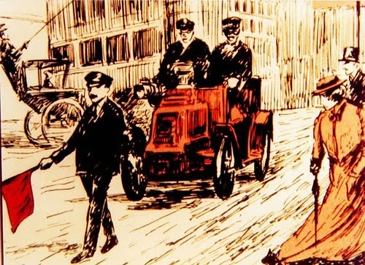

Slide 4
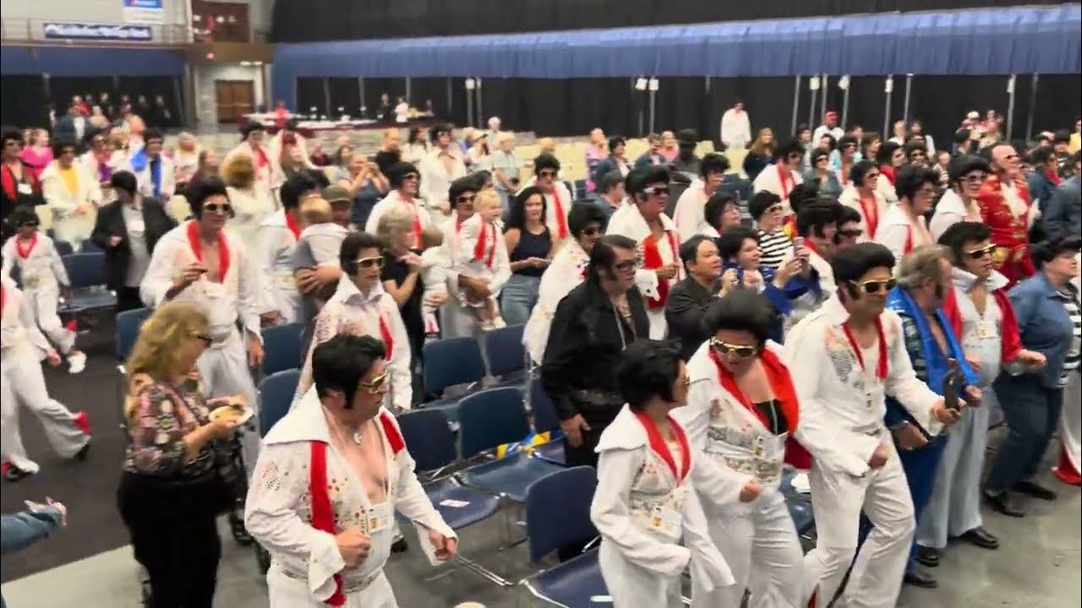

Slide 5
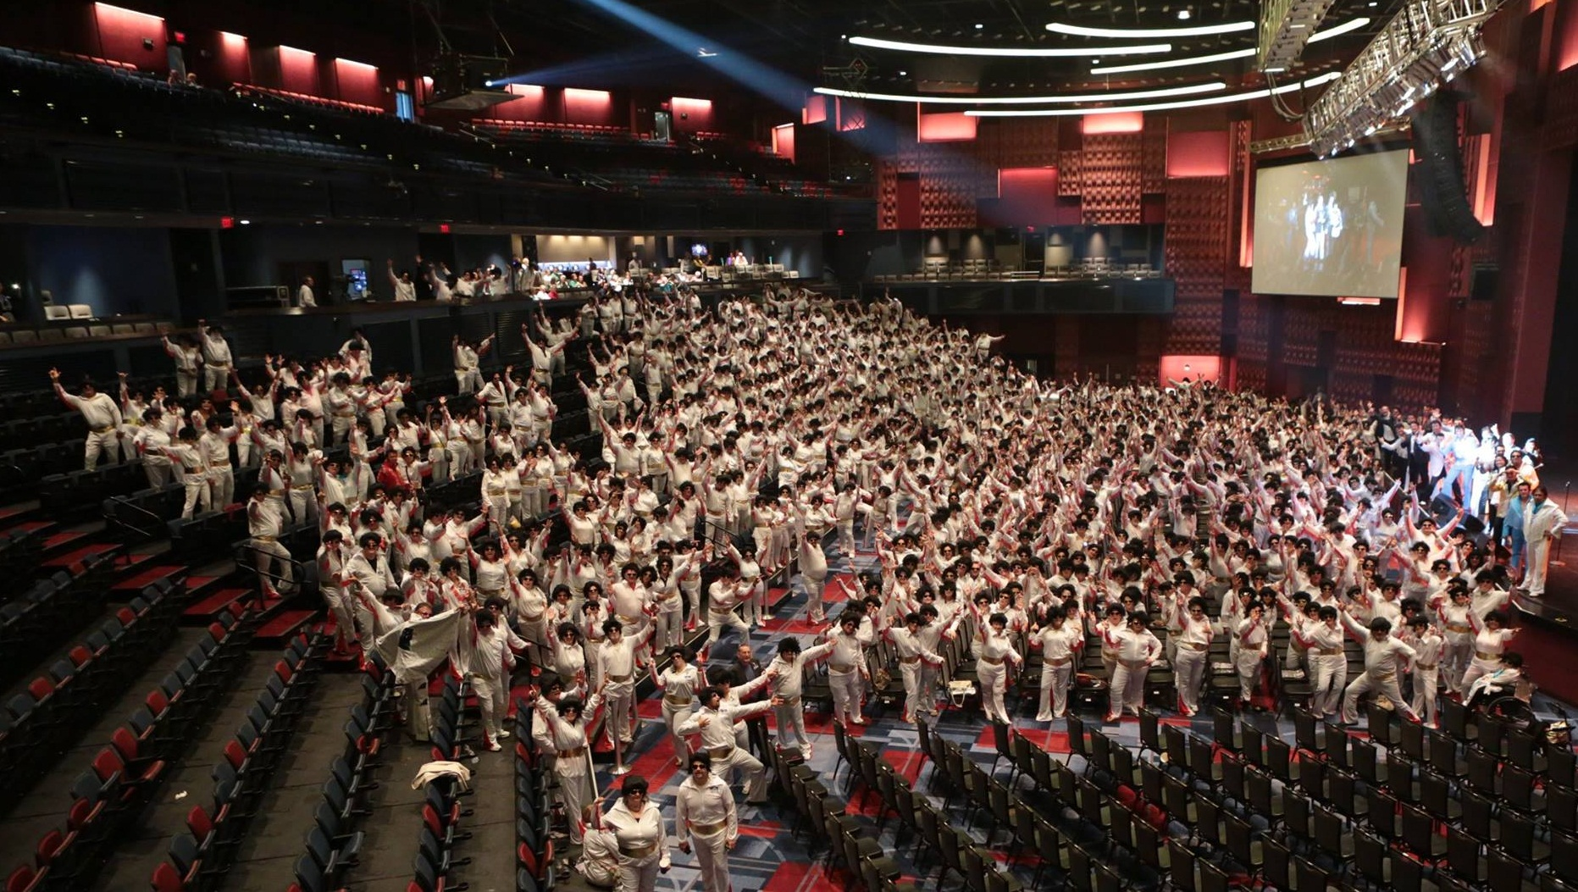

Slide 6
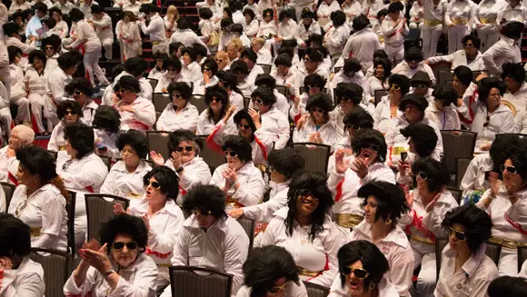

Slide 7
Systems Thinking
teaches that the only way to change complex systems
is by changing the values and assumptions on which they are built

Slide 8
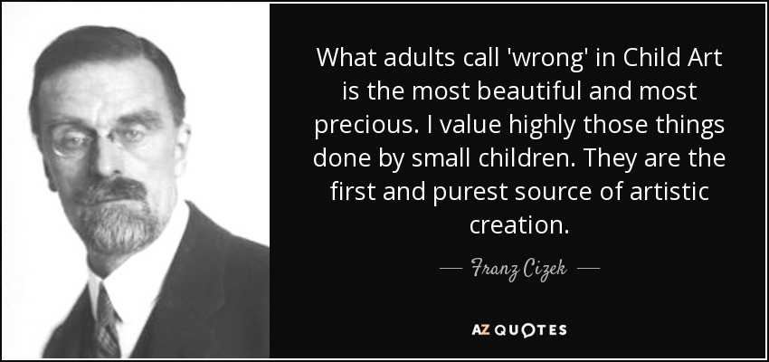

Slide 9
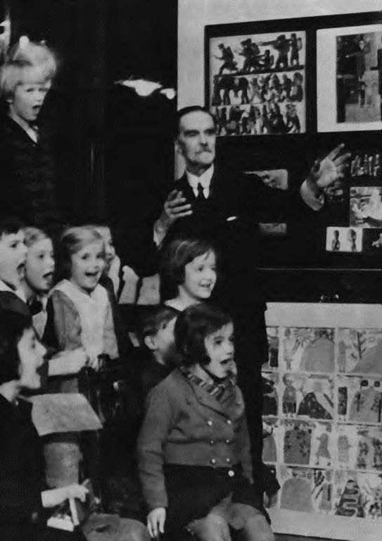
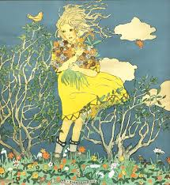

Slide 10
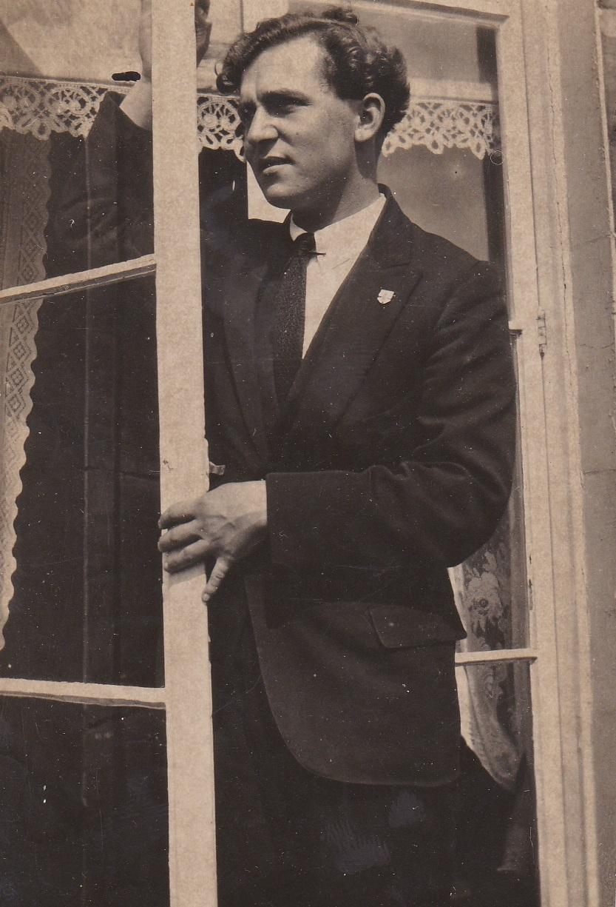
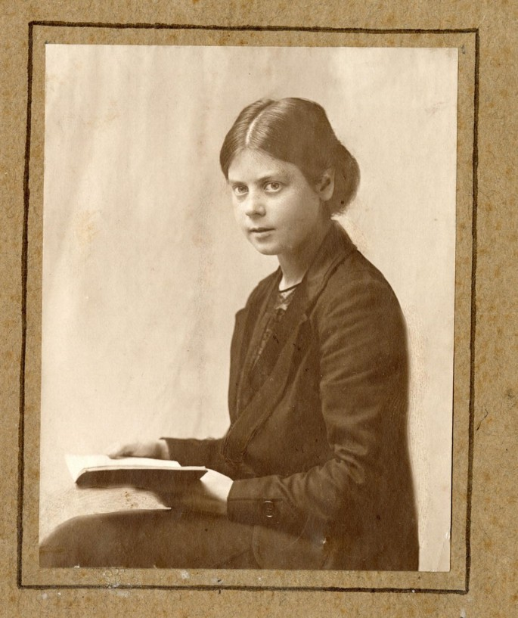
Robin
Tanner
Marion Richardson

Slide 11
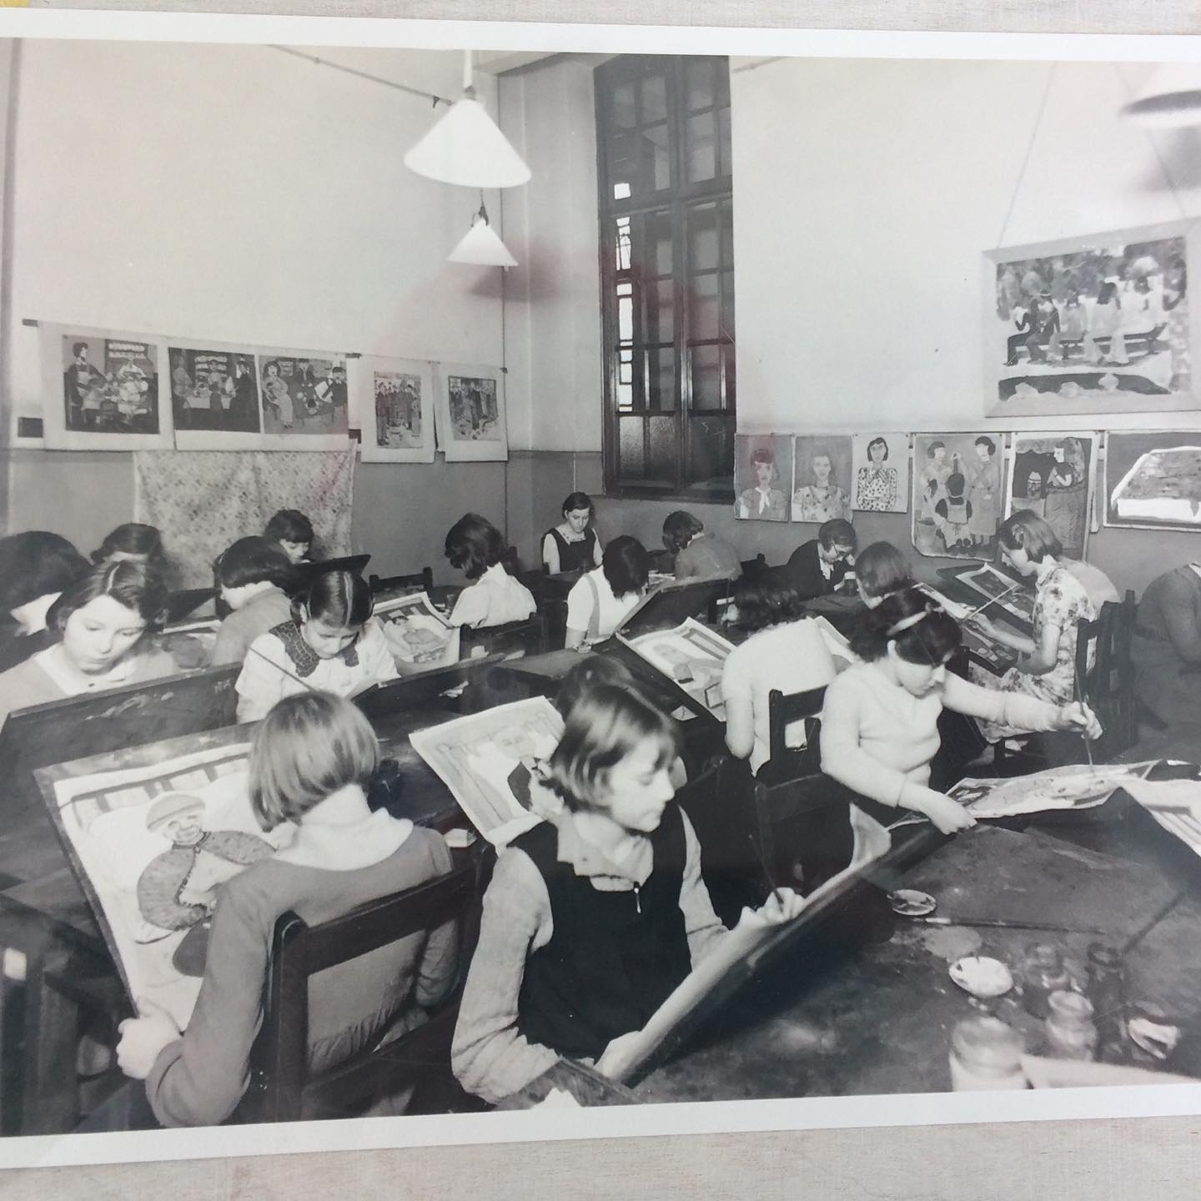

Slide 12
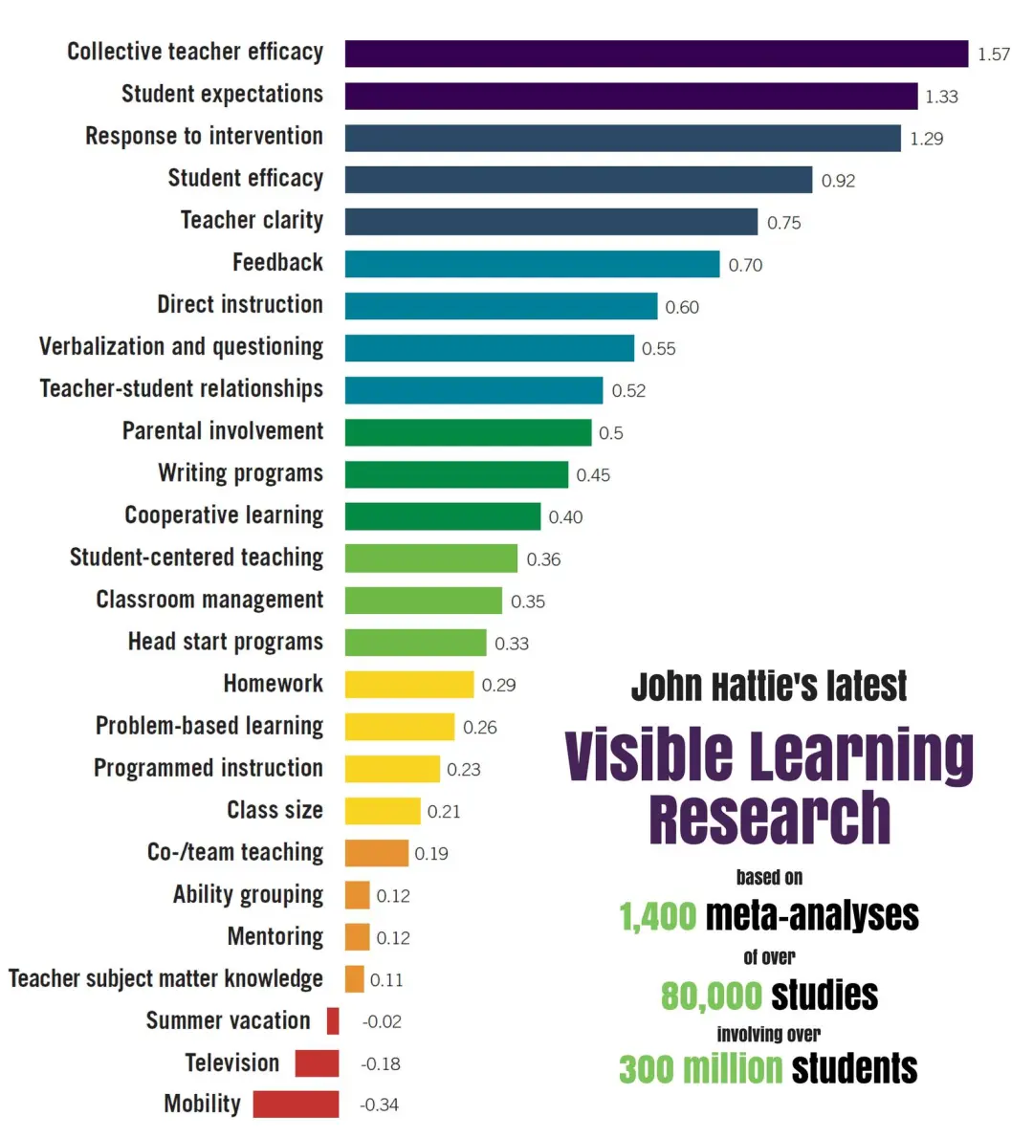

Slide 13
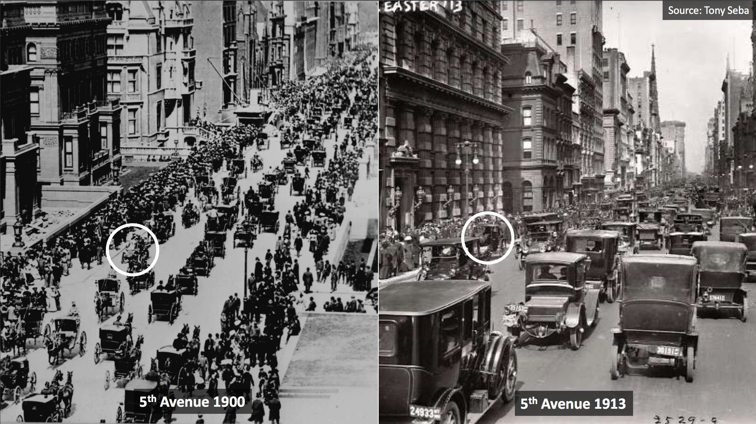

Slide 14
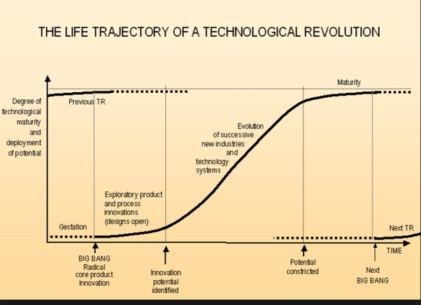

Slide 15
Apart from Chat GPT 4, Dall-E and Midjourney
khanmigo.ai for teachers and parent sponsored student access
dreamstudio.ai/generate Images from text prompts
huggingface.co/chat chat letting you communicate with language models
splinedesign/ai 3D objects and textures
stableaudio.com Create music and sound effects
aws.amazon.com/codewhisperer Generates code suggestions
myheritage.com/deep-nostalgia Animate your family photos

Slide 16
Next steps
Play
Learn to prompt effectively
Take a free course

Slide 17

Any questions?

