Slide 1
Supporting Young People to become Global Citizens
British Council Partner Schools
Annual Event – Andes Cluster – Barranquilla – April 2023
Notes:
Myself
Previous role
Current role
Use of QR codes and surveys! Have wifi/phone ready

Slide 2
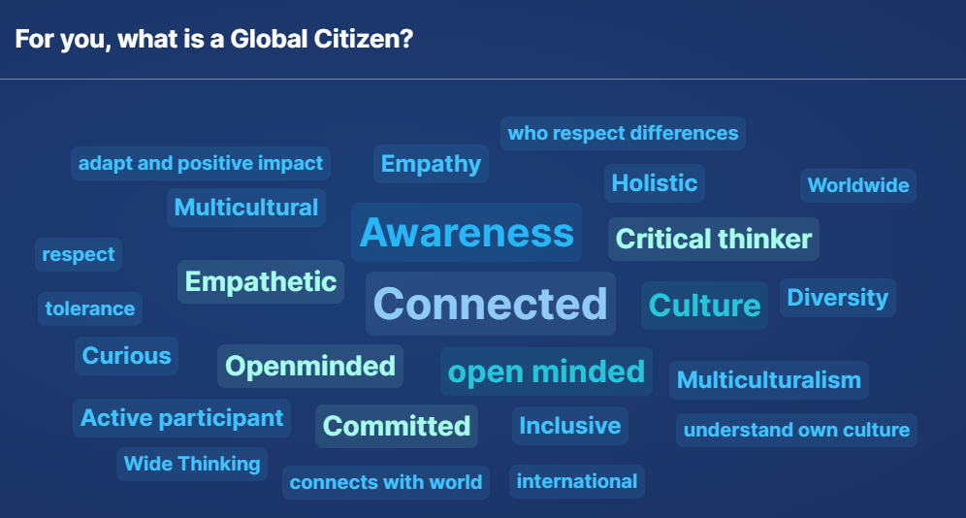
What is a Global Citizen?

Slide 3

Some definitions of Global Citizens…
A global citizen is someone who is aware of and understands the wider world – and their place in it.
They are a citizen of the world.
They take an active role in their community and work with others to make our planet more peaceful, sustainable and fairer.
They are open to engaging positively with other identities and cultures and being able to recognise and challenge stereotypes.
They are globally competent

Slide 4
Why is it important for our pupils to be globally competent? Audience survey responses:
To be able to understand the world and solve global situations
They must to understand the world that is actually in constantly evolving.
To create sense of a single community and working together for global well-being.
To undestand and live humanity with awareness and commitment
A person that can carry out any task in different scenarios.
To fit in
Be an active participant of how the world works
It helps them to be empowered of their role in their community and society.
Integral formation
So he/she communicates with other cultures
Comunicación
develop the awareness they need to become active and responsible global citizens who are able to contribute to a more just, peaceful, and sustainable world.
Is the way to be part of everything, the way to Connect yourself with your work and your personal life
Participate actively
It is the only way we can survive as a species
Social skills development
Leadeeship and autonomy
To open their minds
Because the world is interconnected and students need to know how globalization may bring both positive and , perhaps, even negative ones and then find solutions to the possible issues.
They must know what they can encounter outside of their world and need basic skills to live in it
To be able to make a positive empact in our community or anywhere they choose to be.
Because they are the base of a global community
Understand global issues and assume an important role on it
They will able to take part in significant change effectively
To make sure they are ready for a globalized world with its challenges and differences.
Awareness of global issues
They need to engage in the global dialogue to face the challenges that the future can bring.
To be able to make responsible and informed decisions in the roles they have
To succeed in the world that awaits them
So they can positively contribute to an increasingly interconnected world and deal in situations with empathy, innovation, and cultural understanding.
Understanding the purpose of education
To lider new perspectivas
To understand the world
We are all one!
they live in a globally connected world, that becomes more united as time moves forward. Being globally competent will help them thrive in their chosen paths for the future.
To be able to solve problems.
To be part of the solutions of the issues the 21st century demmands
World of work.
Companies want the skills.
To be able to be part of the world and understand how the world has changed and what they could do to make it better. Solve problems.
carry out
To take an active role.
Because the world is our home, and we need to understand this oneness and therefore equally shared responsibility for it.
promove critical thinking
So they can create a peacful Word based on equality and human rights
To generate opportunities to others
To change harmful and selfish mindsets
To be able to see what is wrong and take action to correct it

Slide 5
Why is it important for our pupils to be globally competent? Audience survey responses (contd):
It will ensure that they can be productive and resourceful anywhere life takes them in their future.
For them to transform ideas in actions.
To understand life and play a part in solving world challenges
So they may be able to interact and collaborate with others in whatever context they encounter in their lives
To be able to understand different perspectives and influence others
To be able to interact with others
It allows them to be 21st century citizens.
to be able to perform
Could save us from major conflict and war
Emphatic
To be able to face a globalized world
Respect differences and understand other points of view
To join with other people to achieve common goals.
Nowadays culture can't be confined to one country or region.
It gives them adaptability
Young people need to save the world! Together!
To make changes according to the world experiences!!
They arw already immersed in a global learning environment
The world is a wide community. We need them to think collectively.
To develop accesible solutions at a global level
To understand difference and how to mediate conflict
To face all the challenges they have in terms of academy, life skills and cultural awareness
Promote understanding of a global mindset
To be a change agent
Understand the world from many perspectives
Be successful in life
Prepares them to thrive in a globalized world
Because they will be better prepared for the challenges that globalization brings about.
It fosters peace amongst countries. It builds trust, collaboration and respect beyond our borders.
Interact with different culture res
To be part of all the changes and be a change by themselves to make the world better
To know how to live in community
It is essential to become more respectful and value their own culture and traditions, to be aware of their community’s needs and what solutions they could implement to help others.
Because is the future of the world
To contribute to global harmony and solutions
To be active part of the world.
sonthat they can understand and respond to change
To have an impact, succeed
Active contributors of ideas and actions
This way they will prepared to today’s world.
To be Competitive
There is no choice
Identify
They're members of an international community
To be more human
For them to be more resilient
To be confident with where they are and where they can go.
To enable them to make a difference and navigate today’s world effectively
Its a must
Empathetic
Interact and impact
Today's world's issues require worldwide collaboration
To help solve modern day problems and challenges.
They will most likely have to live abroad in the future.
To reach their potential
To understand the world
to contribute to building a better world
To Understand the world
World is global now, high interaction ww
To transform realities that need to be transformed
Yo be able to interact socially and professionally
Communication
Face up with day to day challenges
To be able to make changes
To interact and impact
To create a better world
Soft skills
To take part in the change
Adaptation
To understand different cultures and respect their peers
Migration
To be capable

Slide 6
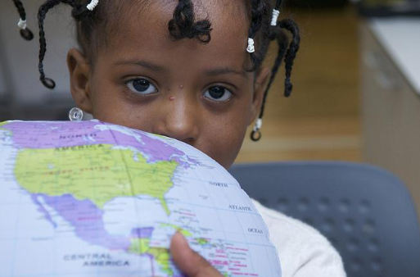
Some reasons why it’s important for our pupils to be globally competent…
Global competence can help young people:
develop cultural awareness and respectful interactions in increasingly diverse societies;
prepare for the world of work;
be open to people from different cultural backgrounds, demonstrate respect for others in a globalised world;
care about global issues and engage in tackling these issues

Slide 7

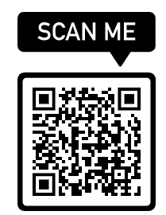
PISA & Global Competence
Since 2018, the OECD has included Global Competence in its Programme for International Student Assessment (PISA) – alongside reading, maths and science
The findings from the first assessment of global competence highlight that the most successful schools in fostering global knowledge, skills and attitudes among their students are those that:
offer a curriculum that values openness to the world
provide a positive and inclusive learning environment
offer opportunities to relate to people from other cultures
have teachers who are prepared for teaching global competence
address global issues in an open and exploratory way
Sample PISA Global Competence questionnaire

Slide 8
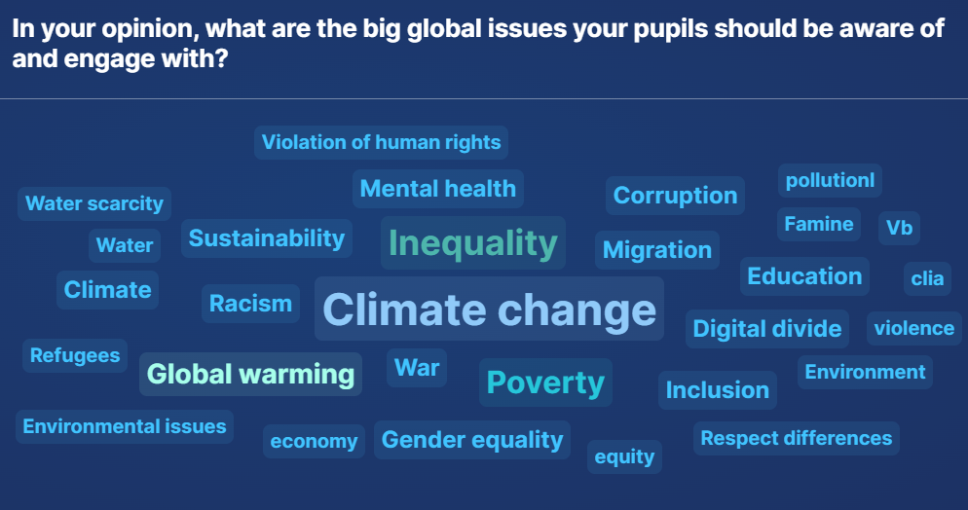
In your opinion, what are the global issues our pupils should be aware of and engage with?

Slide 9
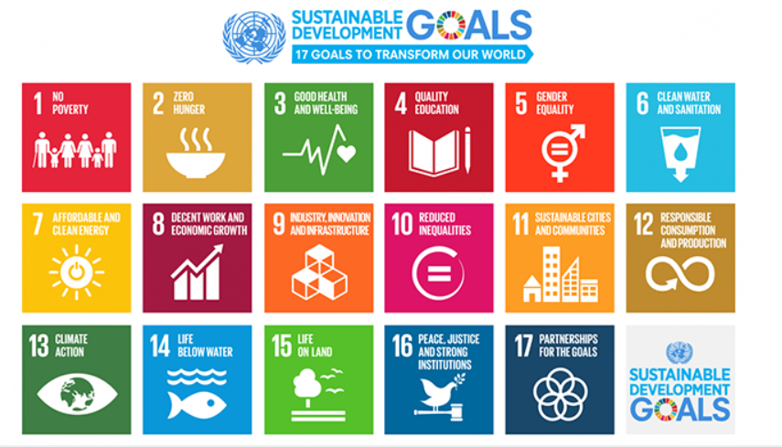
The Sustainable Development Goals

Slide 10
Sustainable Development Goal 4.7
“By 2030 ensure all learners acquire knowledge and skills needed to promote sustainable development…through education for sustainable development and sustainable lifestyles, human rights, gender equality, promotion of a culture of peace and non-violence, global citizenship, and appreciation of cultural diversity…”

Slide 11
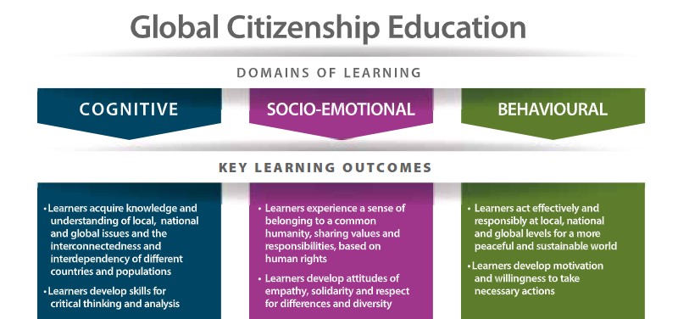
What are the principles of effective learning for pupils to become Global Citizens?
Knowledge (cognitive domain) must touch the heart (socio-emotional domain) and turn into action to bring about positive change (behavioural domain).
UNESCO 2018

Slide 12
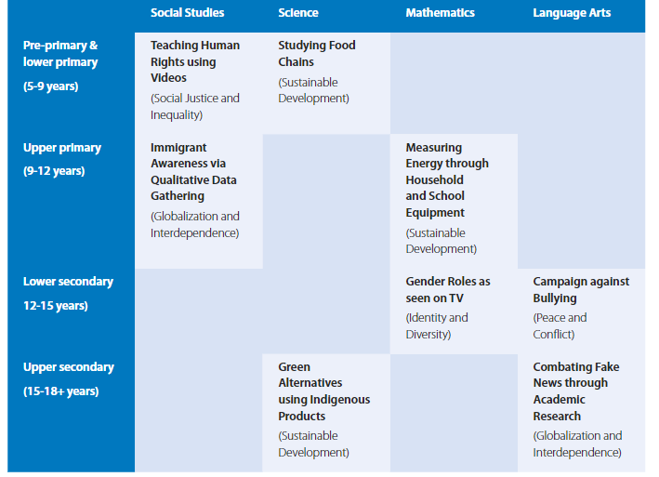
Where is the space for Global Citizenship in the curriculum?
UNESCO 2018

Slide 13
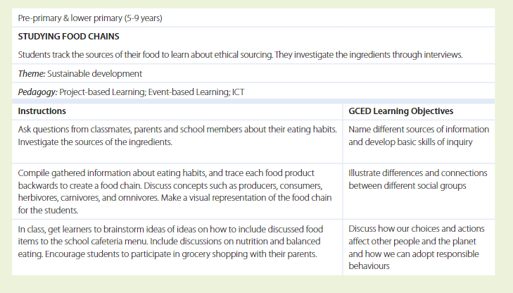
UNESCO 2018

Slide 14
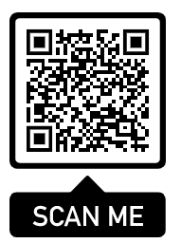
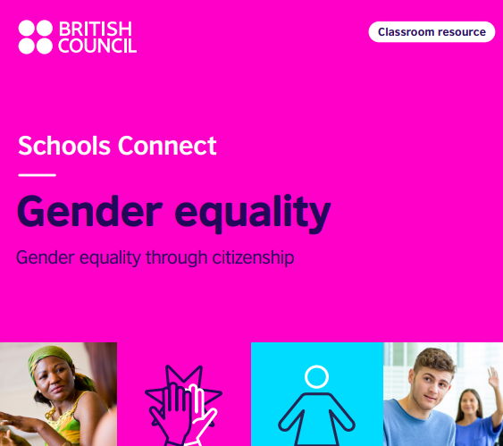
How can British Council support schools to bring Global Competence into the curriculum? Access free ready-made project-based classroom resources here

Slide 15
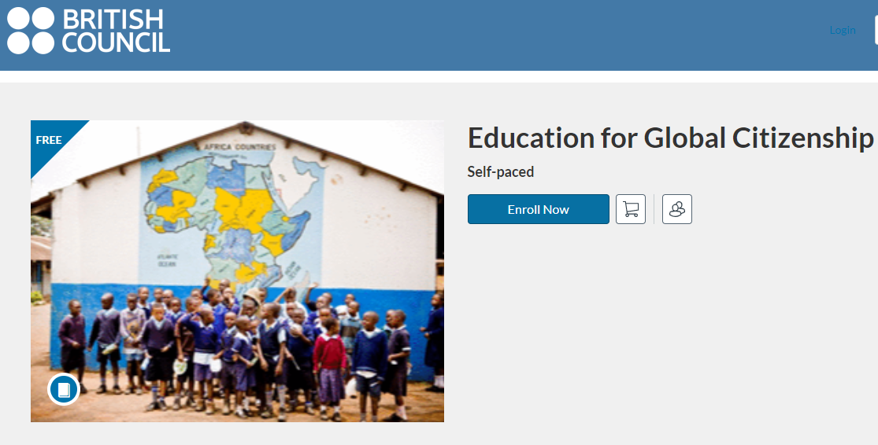
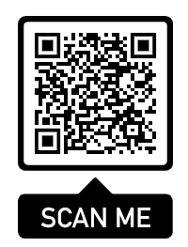
Access free teacher training on Global Citizenship here

Slide 16
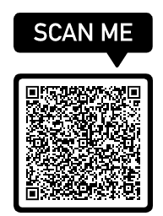
Set up an international school partnership
Register your school on our partner-finding databases
Connect with a school in another country
Establish your partnership – use clear and regular communications
Use one of the free British Council classroom resources to support shared project-based learning
British Council partner-finding database

Slide 17
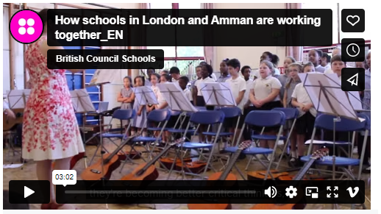
Case study: St Joseph’s (UK) and Marka Prep (Jordan)

Slide 18
Thank you!

