Slide 1
Supporting a global community of schools
British Council Partner Schools
April
2023

Slide 2

Today
Our team
Our offer
Schools Now!
Online Support for Schools
Action Research Grants
School Counsellor Training
Partner Schools Connect
Your World
Coming soon:
Leaders' dashboard
*Well-being framework
UNICEFs Safeguarding Course

Slide 3
Our Education team
Douglas Wood
Thomas Evans
Charlotte Weatherilt

Slide 4
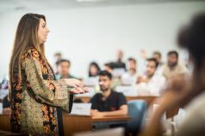
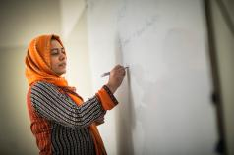
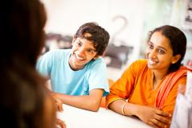
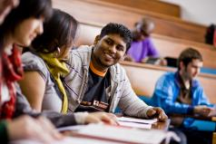
Professional development and training support
Leaders
Teachers
We provide a wealth of extra, education support services and resources to our Partner Schools - supporting leaders, teachers, students and parents in their education journey with UK international school qualifications.
Parents
Students

Slide 5


Slide 6
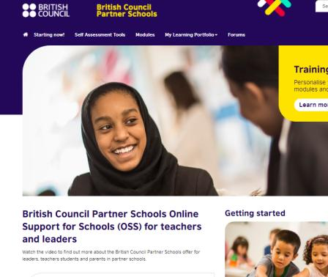
Online Support for Schools
Online Support System (OSS) provides convenient, flexible and unlimited access for teachers and school leaders
Features:
Find courses and modules for your needs
Develop your skills, track progress and share your success
Connect with experts and teachers around the world to learn, teach and develop projects
Find out about the latest thoughts from experts
Notes:
200,000 modules completed since launch
97,500 users since launch
Web page open
Ask question
Show screen for feedback

Slide 7
Action Research Grants
The aims of this research are:
Raise educational standards by addressing the latest challenges and developments through innovation
Improve the learning experiences for thousands of students by supporting our global community of Partner Schools
Share and build the knowledge and skills of our community through training, events and published papers.
Nearly 200 applications globally.
We are currently in the process of shortlisting candidates
Missed out this year? Visit the ‘My Resources’ section on the Online Support for Schools (OSS) platform for guidance on how to conduct action research in your school.​
Notes:
Direct towards my resources

Slide 8
Refreshed Partner Schools Connect
Notes:
Play video

Slide 9

Refreshed E Safety Posters and Guides
British Council Partner Schools has developed three e-safety brochures to support schools, parents, carers and children to keep young people safe in the online world:
Digital Life Hacks for Kids – tips for young people to stay safe
Digital Life Hacks for Parents and Carers – a family-based approach to online safety
Online Safety Resource for Schools – how schools can develop an inclusive and effective e-safety policy
These are in addition to posters and safeguarding posters found on the OSS.
Notes:
Available here
And on OSS

Slide 10
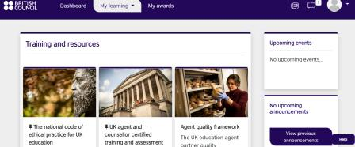
Counsellor training
The entire training programme and assessment is now free of charge and there is no registration or certification fee charged to our Partner Schools. The course is 100% online and will provide you with essential information about the UK as a study destination such as:
Why students should choose the UK as a study destination
The UK’s education system(s)
Preparing students for studying and living in the UK
The UK’s visa and immigration system
Employment opportunities and post-study work options
The training hub is a one stop-shop for all the resources that you will need to advise students
https://www.britishcouncil.org/education/education-agents/training-agents

Slide 11


Your World Global Competition for students
Global video making competition for students aged 14-17 years
Notes:
Your World is a global video making annul competition for students aged from 14-17 years old. The competition is an excellent opportunity for young people to showcase their creativity. They are tasked to create a social action project that highlights an issue in their community and suggests solutions to overcome the issue. Students can draw on their cross-curricular knowledge to produce a truly exceptional video while also developing these core skills such as digital literacy, collaboration and critical thinking.
The Your World links directly to the United Nations Sustainable Development Goals. The competition goes from strength to strength with over 750 entries and participation of over 3500 students.

Slide 12
Developments in the background
Coaching courses for leaders
Train the trainer programmes
Study Tours
Dashboard for leaders
Well-being framework training
UNICEF Course

