Slide 1

Applications of AI in Education

Slide 2

Chat GPT – a Game Changer
Notes:
Curriculum was structured within a dominance of the core subjects, in terms of the need to master related contents which were deemed more important and useful for further studies and the workplace.

Slide 3
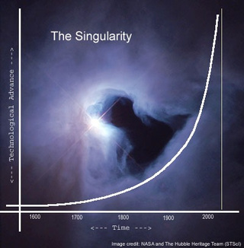
The Singularity
Notes:
Curriculum was structured within a dominance of the core subjects, in terms of the need to master related contents which were deemed more important and useful for further studies and the workplace.

Slide 4

Augmented Reality
Notes:
Curriculum was structured within a dominance of the core subjects, in terms of the need to master related contents which were deemed more important and useful for further studies and the workplace.

Slide 5
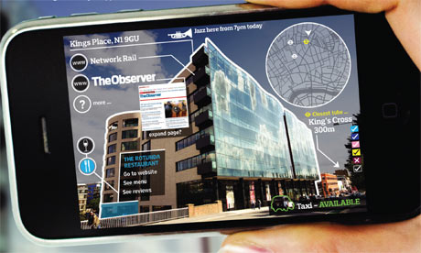
Augmented Reality
Notes:
Curriculum was structured within a dominance of the core subjects, in terms of the need to master related contents which were deemed more important and useful for further studies and the workplace.

Slide 6

Virtual Reality
Notes:
Curriculum was structured within a dominance of the core subjects, in terms of the need to master related contents which were deemed more important and useful for further studies and the workplace.

Slide 7
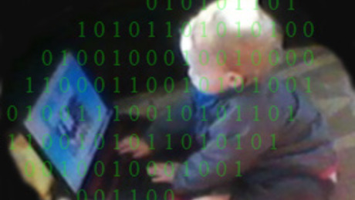
Big Data

Slide 8

The Black Box Effect

Slide 9
AI in Education
Chat GPT
Deep Learning Neural Network.
Reinforcement learning, based on human feedback, was used for training.
Most advanced Natural Language Processing model ever.
Worst version we will experience.

Slide 10
AI in Education
Biases and human reinforcement
Early models presented biases from data corpora.
Gender biases.
Racial and ethnic biases.
De-biasing.

Slide 11
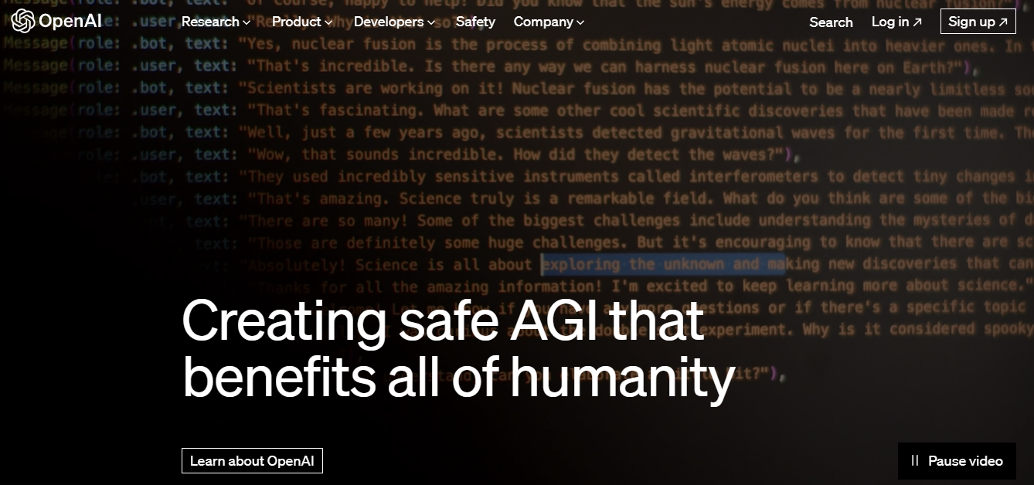
OpenAI

Slide 12
AI in Education
Risks of neural networks
Pneumonia research – rules model vs. neural networks.
Opaqueness of model vs. accuracy.
Transparency initiatives.
Do people have the right to explanations when algorithmic decisions are made?

Slide 13
Chat GPT
Limitations and implications
Pre-trained, not real time or organic.
No information post 2022.
Closed knowledge base.
Very expensive model.
Human input for training.
Never 100% error free.

Slide 14
Ethical and social implications
AI Image Generation
Is it Art?
Concerns for digital art industry.

Slide 15
Ethical and social implications
AI Image Generation
Misuse and Misrepresentation of AI-Generated Images
Privacy and Consent Concerns
Deepfakes and Non-consensual Content Issues
Bias and Stereotypes in AI Image Generation

Slide 16
Ethical and social implications
AI Image Generation
Ownership and Intellectual Property Rights Challenges
Authenticity and Trust Concerns in Visual Media
Psychological and Emotional Impact of AI-Generated

Slide 17
Ethical and social implications
AI and advanced tech applications
Unaddressed important implications of tech advances.
Students are generally unaware of some of the deeper issues related to technology.
These range from ethical dilemmas and deep fakes to privacy issues.

Slide 18
Conclusions - Discussion
This is just the beginning
Chat GPT elevates the threshold of cognitive skills at every level.
What constitutes cheating?
Different standards for adults and students?

Slide 19
Conclusions - Discussion
This is just the beginning
Which learning / cognitive skills do we need to build up to?
How are they learned?
Reassessing assessment, including international exams.
Current events post Sept 2021 - limitations

Slide 20
Conclusions - Discussion
Implications
Redefine cognitive skills per age level.
Closed tech sessions – oral discussions – not pen and paper.
Pre-Chat GPT analysis.
Fact checking and verification.
Creative tasks.

Slide 21
Conclusions - Discussion
Risks
Some cognitive skills at risk.
  Reading comprehension.
  Summarization.
  Breaking down a real life problem.
Chat GPT outperforming students at many age levels.

Slide 22
Conclusions - Discussion
Benefits
We can learn a whole lot more.
Very significant step towards democratization of knowledge.
Higher threshold for learning skills.
AI unleashed for human good.

Slide 23

What´s next?

Slide 24

gabriel.rshaid@thelearnerspace.org

